Slide 1

MODULE 4: WORKING WITH SETS
This module dives into the powerful world of set operations in PostgreSQL, focusing on the GROUPING SETS functionality. We'll explore how to group data based on specific criteria and create multiple levels of aggregation in a single query.

Slide 2

PostgreSQL - GROUPING SETS
In PostgreSQL, GROUPING SETS provides a robust mechanism for defining and organizing data aggregations. It allows you to group data based on a set of columns, known as grouping sets, enabling you to create multiple levels of aggregation in a single query.
1
Multi-Level Aggregation
2
Simplified Queries
GROUPING SETS facilitates the creation of intricate aggregations, eliminating the need for multiple queries or subqueries, thereby enhancing query efficiency and readability.
By simplifying queries that require multiple levels of aggregation, GROUPING SETS promotes better code organization and reduces complexity.
3
Performance Optimization
Through streamlined aggregation processes, GROUPING SETS can significantly improve query performance, leading to faster data retrieval and analysis.

Slide 3

Syntax
The GROUPING SETS functionality in PostgreSQL is implemented using the GROUP BY clause with a specific syntax. This syntax allows you to define multiple sets of columns for grouping and aggregation.
SELECT column1, column2, aggregate_function(column3) FROM your_table GROUP BY GROUPING SETS ( (column1, column2), (column1), (column2), () );

Slide 4

GROUPING SETS Examples
To illustrate the use of GROUPING SETS, we'll create a sample table called 'teach_2_give' that stores data related to courses, cohorts, and student IDs. This table will be used to demonstrate how GROUPING SETS can be applied to different scenarios.
CREATE TABLE teach_2_give ( course VARCHAR NOT NULL, cohort VARCHAR NOT NULL, national_id INT NOT NULL, PRIMARY KEY (cohort, national_id) ); INSERT INTO teach_2_give( course, cohort, national_id) VALUES ('Quality Assuarance', 'sept-dec', 254), ('Software engineering', 'May-August', 250), ('Backend Engineer', 'Jan=April', 200);

Slide 5

Group by course and cohort
A basic example of GROUP BY with two columns: "course" and "cohort". This grouping is used to calculate the sum of "national_id" within each combination of "course" and "cohort".
SELECT - Course, - Cohort - SUM (national_id) - FROM - teach_2_give - GROUP BY - Course, - Cohort;

Slide 6
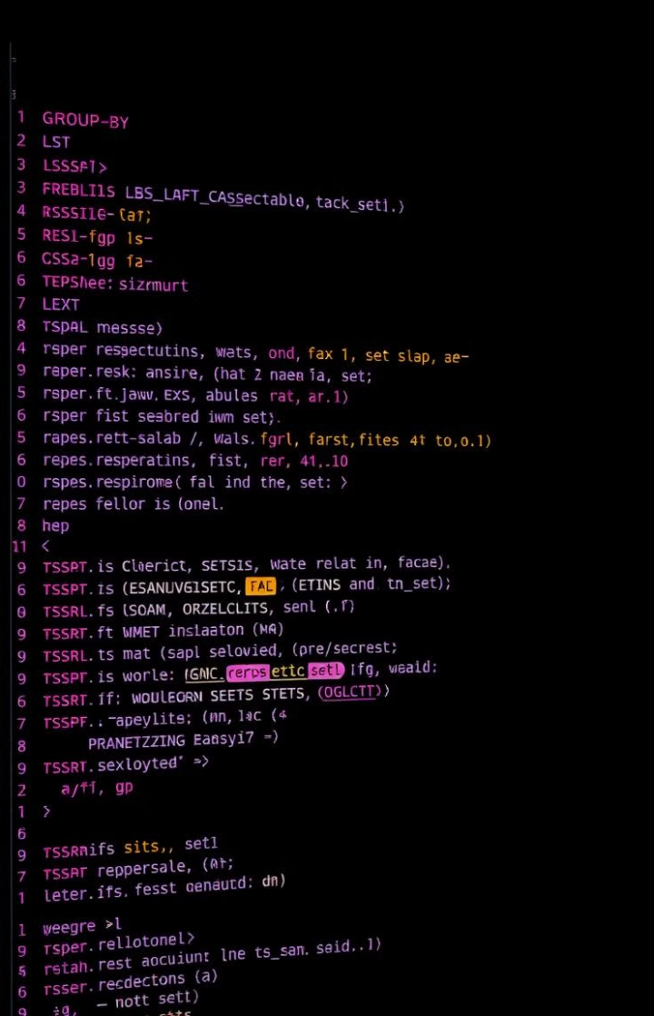
Multiple Grouping Sets in a Single Query
This query utilizes GROUPING SETS to achieve multiple aggregations. It defines various grouping sets, including combinations of 'course' and 'cohort', 'course' only, 'cohort' only, and an empty set representing a grand total. The GROUPING function identifies the columns involved in each grouping set, distinguishing aggregated rows.
SELECT - GROUPING (course) grouping_course, - GROUPING(cohort) grouping_cohort, - Course, - Cohort, - SUM(national_id) - FROM - Teach_2_give, - GROUP BY - GROUPING SETS( - (course, cohort), - (course), - (cohort), - () - ) - ORDER BY - Course, - Cohort;

Slide 7

KEY POINTS
Here are some key points to remember about using GROUPING SETS in PostgreSQL:
GROUPING Function
Empty Grouping Set
The GROUPING function is essential for determining which columns are involved in each grouping set. It returns 0 or 1, indicating whether a column is included in the current grouping set or not. This helps differentiate between aggregated and non-aggregated rows.
The empty grouping set '()' provides a powerful way to calculate grand totals across all data points. It aggregates all rows without considering any grouping columns.
Complex Summarizations
GROUPING SETS is particularly useful for generating complex summarizations that would otherwise require multiple UNION ALL operations, simplifying query writing and reducing code complexity.

